Slide 1
Searching, Sorting and Greedy Algorithms
Searching, Sorting and Greedy Algorithms
SoftUni Team
Technical Trainers
Software University
https://softuni.bg

Slide 2
Have a Question?
sli.do
#Algorithms-Java

Slide 3
Table of Contents
Searching Algorithms
Linear Search
Binary Search
Simple Sorting Algorithms
Selection and Bubble Sort
Shuffling
Advanced Sorting Algorithms
QuickSort, MergeSort, BucketSort
Greedy Algorithms
3
Notes:
3

Slide 4


Searching Algorithms
Linear, Binary and Interpolation

Slide 5
Search Algorithm
Search algorithm == an algorithm for finding an item with specified properties among a collection of items
Different types of searching algorithms:
For virtual search spaces
Satisfy specific mathematical equations
Try to exploit partial knowledge about a structure
For sub-structures of a given structure
A graph, a string, a finite group
Search for the min/max of a function, etc.

Slide 6
Linear Search
Linear search finds a particular value in a list
Checking every one of the elements
One at a time, in sequence
Until the desired one is found
Worst & average performance: O(n)
for each item in the list:
if that item has the desired value,
return the item's location
return nothing

Slide 7
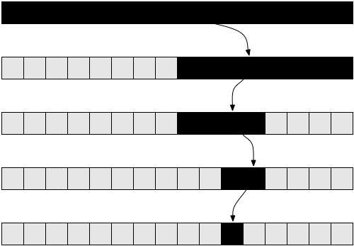
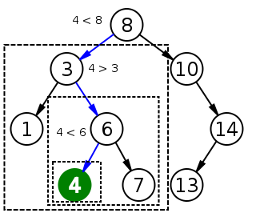
Binary Search
Binary search finds an item within a ordered data structure
At each step, compare the input with the middle element
The algorithm repeats its action to the left or right sub-structure
Average performance: O(log(n))
See the visualization

Slide 8
Binary Search (Iterative)
int binarySearch(int arr[], int key, int start, int end) {
while (end >= start) {
int mid = (start + end) / 2;
if (arr[mid] < key)
start = mid + 1;
else if (arr[mid] > key)
end = mid - 1;
else
return mid;
}
return KEY_NOT_FOUND;
}

Slide 9

Simple Sorting Algorithms
Selection Sort and Bubble Sort

Slide 10
What is a Sorting Algorithm?
Sorting algorithm
An algorithm that rearranges elements in a list
In non-decreasing order
Elements must be comparable
More formally
The input is a sequence/list of elements
The output is an rearrangemen/permutation of elements
In non-decreasing order

Slide 11

Sorting – Example
Efficient sorting algorithms are important for:
Producing human-readable output
Canonicalizing data – making data uniquely arranged
In conjunction with other algorithms, like binary searching
Example of sorting:
Unsorted list
sorting
Sorted list
10 | 3 | 7 | 3 | 4
3 | 3 | 4 | 7 | 10

Slide 12
Sorting Algorithms: Classification
Sorting algorithms are often classified by:
Computational complexity and memory usage
Worst, average, and best case behavior
Recursive/non-recursive
Stability – stable/unstable
Comparison-based sort/non-comparison based
Sorting method: insertion, exchange (bubble sort and quicksort), selection (heapsort), merging, serial/parallel, etc.

Slide 13
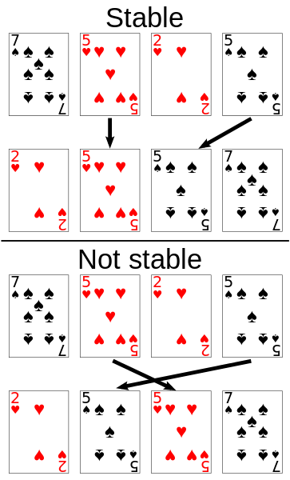
Stability of Sorting
Stable sorting algorithms
Maintain the order of equal elements
If two items compare as equal, their relative order is preserved
Unstable sorting algorithms
Rearrange the equal elements in unpredictable order
Often different elements have the same key used for equality comparing

Slide 14
Selection Sort
Selection sort – simple, but the inefficient algorithm
Swap the first with the min element on the right, then the second, etc.
Memory: O(1)
Stable: No
Method: Selection

Slide 15
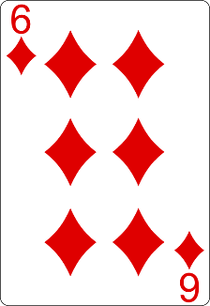
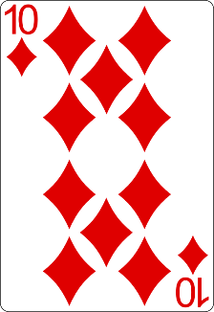
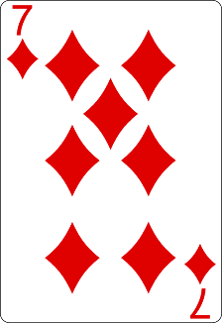
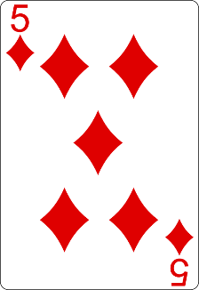
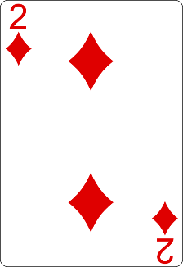
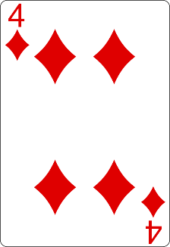
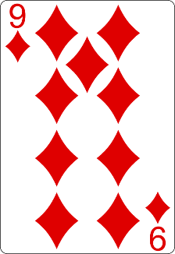
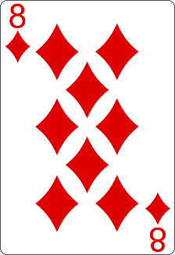
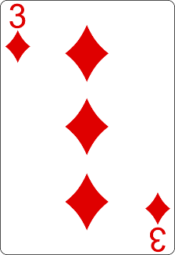
Selection Sort Visualization (1)
Index
Min

Slide 16
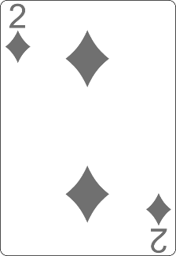
Selection Sort Visualization (2)
Index
Min

Slide 17
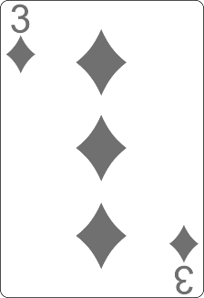
Selection Sort Visualization (3)
Index
Min

Slide 18
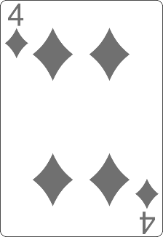
Selection Sort Visualization (4)
Min
Index

Slide 19
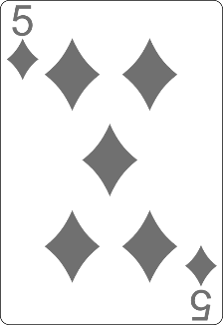
Selection Sort Visualization (5)
Min
Index

Slide 20
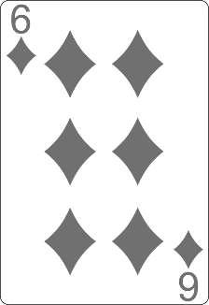
Selection Sort Visualization (6)
Min
Index

Slide 21
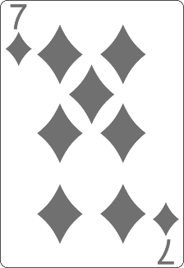
Selection Sort Visualization (7)
Index
Min

Slide 22
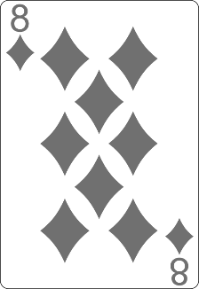
Selection Sort Visualization (8)
Min
Index

Slide 23
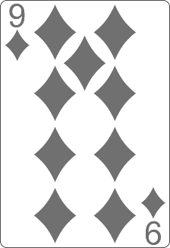
Selection Sort Visualization (9)
Min
Index

Slide 24
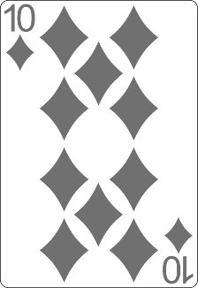
Selection Sort Visualization (10)

Slide 25
Selection Sort Visualization (11)

Slide 26
Selection Sort Code
for (int index = 0; index < arr.length; index++) { int min = index; for (int curr = index + 1; curr < arr.length; curr++) { if (arr[curr] < arr[min]) { min = curr; } } swap(arr, index, min); }

Slide 27
Comparison of Sorting Algorithms
Name | Best | Average | Worst | Memory | Stable | Method
Selection | n² | n² | n² | 1 | No | Selection

Slide 28
Bubble Sort
Bubble sort – simple, but an inefficient algorithm
Swaps to neighbor elements when not in order until sorted
Memory: O(1)
Stable: Yes
Method: Exchanging

Slide 29
Bubble Sort Visualization (1)
i
j

Slide 30
Bubble Sort Visualization (2)
i
j

Slide 31
Bubble Sort Visualization (3)
i
j

Slide 32
Bubble Sort Visualization (4)
i
j

Slide 33
Bubble Sort Visualization (5)
i
j

Slide 34
Bubble Sort Visualization (6)
i
j

Slide 35
Bubble Sort Visualization (7)
i
j

Slide 36
Bubble Sort Visualization (8)
i
j

Slide 37
Bubble Sort Visualization (9)
i
j

Slide 38
Bubble Sort Visualization (10)
i
j

Slide 39
Bubble Sort Visualization (11)
i
j

Slide 40
Bubble Sort Visualization (12)
i
j

Slide 41
Bubble Sort Visualization (13)
i
j

Slide 42
Bubble Sort Visualization (14)
i
j

Slide 43
Bubble Sort Visualization (15)
i
j

Slide 44
Bubble Sort Visualization (16)
i
j

Slide 45
Bubble Sort Visualization (17)
i
j

Slide 46
Bubble Sort Visualization (18)
i
j

Slide 47
Bubble Sort Visualization (19)
i
j

Slide 48
Bubble Sort Visualization (20)
i
j

Slide 49
Bubble Sort Visualization (21)
i
j

Slide 50
Bubble Sort Visualization (22)
i
j

Slide 51
Bubble Sort Visualization (23)
i
j

Slide 52
Bubble Sort Visualization (24)
i
j

Slide 53
Bubble Sort Visualization (25)
i
j

Slide 54
Bubble Sort Visualization (26)
i
j

Slide 55
Bubble Sort Visualization (27)
i
j

Slide 56
Bubble Sort Visualization (28)
i
j

Slide 57
Bubble Sort Visualization (29)
i
j

Slide 58
Bubble Sort Visualization (30)
i
j

Slide 59
Bubble Sort Visualization (31)
i
j

Slide 60
Bubble Sort Visualization (32)
i
j

Slide 61
Bubble Sort Visualization (33)
i
j

Slide 62
Bubble Sort Visualization (34)
i
j

Slide 63
Bubble Sort Visualization (35)
i
j

Slide 64
Bubble Sort Visualization (36)

Slide 65

BubbleSort
Live Demo

Slide 66
BubbleSort
int[] numbers = {1, 3, 4, 2, 5, 6};
for (int i = 0; i < numbers.length; i++) {
for (int j = i + 1; j < numbers.length - 1; j++) {
if (numbers[i] > numbers[j]) {
int tempNumber = numbers[i];
numbers[i] = numbers[j];
numbers[j] = tempNumber;
}
}
}
//TODO: Print numbers

Slide 67
Comparison of Sorting Algorithms
Name | Best | Average | Worst | Memory | Stable | Method
Selection | n² | n² | n² | 1 | No | Selection
Bubble | n | n² | n² | 1 | Yes | Exchanging

Slide 68
Insertion Sort
Insertion Sort – simple, but inefficient algorithm
Move the first unsorted element left to its place
Memory: O(1)
Stable: Yes
Method: Insertion

Slide 69
Comparison of Sorting Algorithms
Name | Best | Average | Worst | Memory | Stable | Method
Selection | n² | n² | n² | 1 | No | Selection
Bubble | n | n² | n² | 1 | Yes | Exchanging
Insertion | n | n² | n² | 1 | Yes | Insertion

Slide 70

Shuffling
Fisher-Yates Shuffle

Slide 71
Shuffling
Shuffling == randomizing the order of items in a collection
Generate a random permutation
The generation of random numbers is too important to be left to chance. —Robert R. Coveyou

Slide 72
Fisher–Yates Shuffle Algorithm
public static <T> void shuffle(T[] source) { Random rand = new Random(); for (int i = 0; i < source.length; i++) { // Exchange array[i] with random element in array[i … n-1] int r = i + rand.nextInt(source.length - i); T temp = source[i]; source[i] = source[r]; source[r] = temp; } }

Slide 73

Advanced Sorting Algorithms
QuickSort, MergeSort, BucketSort

Slide 74
Merge Sort
Merge sort is an efficient sorting algorithm
Divide the list into sub-lists (typically 2 sub-lists)
Sort each sub-list (recursively call merge-sort)
Merge the sorted sub-lists into a single list
Best, average, and worst-case: O(n*log(n))
Memory:
Typically O(n)
With in-place merge can be O(1)
Highly parallelizable on multiple cores / machines → up to O(log(n))

Slide 75
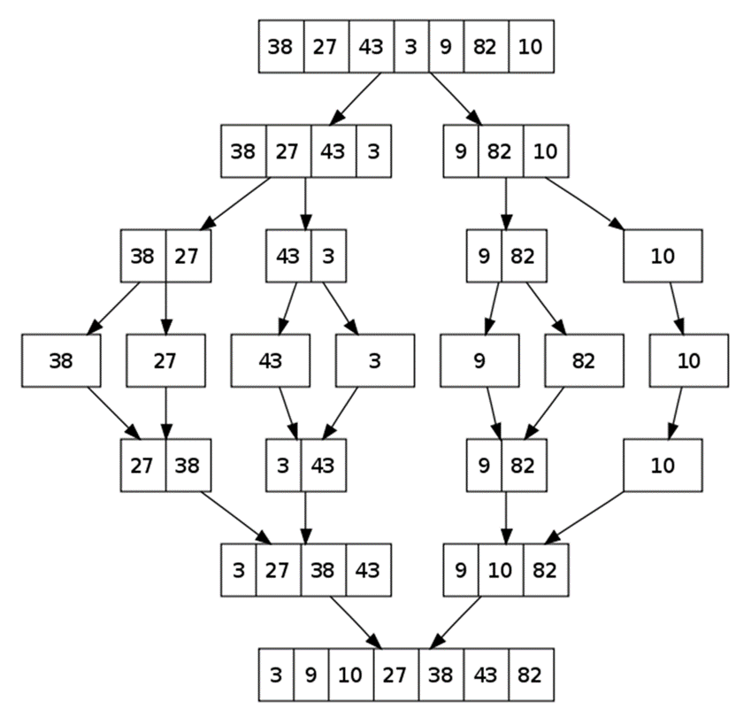
Merge Sort: Hot It Works?

Slide 76
QuickSort
QuickSort – efficient sorting algorithm
Choose a pivot; move smaller elements left & larger right; sort left & right
Best & average case: O(n*log(n)); Worst: O(n2)
Memory: O(log(n)) stack space (for recursion)
Stable: Depends
Method: Partitioning

Slide 77
Counting Sort
Counting sort is a very efficient sorting algorithm
Sorts small integers by counting their occurrences
Not a comparison-based sort
Best, average, and worst-case: O(n + k)
k is the range of numbers to be sorted
E.g. [-1000 ... 1000] → k = 2001
Memory: O(n + k) Space: O(k)
Stable: Yes
Method: Counting

Slide 78
Bucket Sort
Bucket sort partitions an array into a number of buckets
Each bucket is then sorted individually with a different algorithm
Not a comparison-based sort
Average case: O(n + k)
K = the number of buckets
Worst case: O(n * log n)
Stable: Yes (depends on the algorithm)
Memory: O(n) – k buckets holding n elements totally

Slide 79
Comparison of Sorting Algorithms
Name | Best | Average | Worst | Memory | Stable | Method
Selection | n² | n² | n² | 1 | No | Selection
Bubble | n | n² | n² | 1 | Yes | Exchanging
Insertion | n | n² | n² | 1 | Yes | Insertion
Quick | n * log(n) | n * log(n) | n² | 1 | Depends | Partitioning
Merge | n * log(n) | n * log(n) | n * log(n) | 1 (or n) | Yes | Merging
Heap | n * log(n) | n * log(n) | n * log(n) | 1 | No | Selection
Bogo | n | n * n! | n * n! | 1 | No | Luck

Slide 80

Greedy Algorithms
Picking Locally Optimal Solution

Slide 81
Greedy Algorithms
Used for solving optimization problems
Usually more efficient than the other algorithms
Can produce a non-optimal (incorrect) result
Pick the best local solution
The optimum for a current position and point of view
Greedy algorithms assume that always choosing a local optimum leads to the global optimum

Slide 82
Optimization Problems
Finding the best solution from all possible solutions
Examples:
Find the shortest path from Sofia to Varna
Find the maximum increasing subsequence
Find the shortest route that visits each city and returns to the origin city

Slide 83
Greedy Algorithms
Live Demo

Slide 84
Problem: Sum of Coins
Write a program, which gathers a sum of money, using the least possible number of coins
Consider the US currency coins
0.01, 0.02, 0.05, 0.10
Greedy algorithm for "Sum of Coins":
Take the largest coin while possible
Then take the second largest
Etc.
1$
1¢
50¢
5¢
25¢
4¢
Check your solution here: https://judge.softuni.bg/Contests/2454/Searching-Sorting-and-Greedy-Algorithms-Lab

Slide 85
Sum of Coins Visualization
Target: 18
10¢
5¢
2¢
1¢
10¢
5¢
2¢
1¢
Actual:
0

Slide 86
Sum of Coins Visualization
Target: 18
10¢
5¢
2¢
1¢
5¢
2¢
1¢
Actual:
10
10¢

Slide 87
Sum of Coins Visualization
Target: 18
10¢
5¢
2¢
1¢
2¢
1¢
Actual:
15
10¢
5¢

Slide 88
Sum of Coins Visualization
Target: 18
10¢
5¢
2¢
1¢
1¢
Actual:
17
10¢
5¢
2¢

Slide 89

Sum of Coins Visualization
Target: 18
10¢
5¢
2¢
1¢
Actual:
18
10¢
5¢
2¢
1¢

Slide 90
Greedy Algorithm for Sum of Coins
Live Demo

Slide 91
Solution: Sum of Coins (1)
public static Map<Integer, Integer>
chooseCoins(int[] coins, int targetSum) {
List<Integer> sortedCoins = Arrays.stream(coins).boxed()
.sorted(Collections.reverseOrder())
.collect(Collectors.toList());
Map<Integer, Integer> chosenCoins = new LinkedHashMap<>();
int currentSum = 0; int coinIndex = 0;
// Next slide
if (currentSum != targetSum)
throw new IllegalArgumentException();
return chosenCoins;
}
Check your solution here: https://judge.softuni.bg/Contests/2454/Searching-Sorting-and-Greedy-Algorithms-Lab

Slide 92
Solution: Sum of Coins (2)
while (currentSum != targetSum && coinIndex < sortedCoins.size()) {
int currentCoin = sortedCoins.get(coinIndex);
int remainder = targetSum - currentSum;
int numberOfCoins = remainder / currentCoin;
if (currentSum + currentCoin <= targetSum) {
chosenCoins.put(currentCoin, numberOfCoins);
currentSum += numberOfCoins * currentCoin;
}
coinIndex++;
}
Check your solution here: https://judge.softuni.bg/Contests/2454/Searching-Sorting-and-Greedy-Algorithms-Lab

Slide 93
Problem: Set Cover
Write a program that finds the smallest subset of S, the union of which = U (if it exists)
You will be given a set of integers U called "the Universe"
And a set S of n integer sets whose union = U
Universe: 1, 2, 3, 4, 5
Number of sets: 4
1
2, 4
5
3
Sets to take (4):
{ 2, 4 }
{ 1 }
{ 5 }
{ 3 }
Check your solution here: https://judge.softuni.bg/Contests/2454/Searching-Sorting-and-Greedy-Algorithms-Lab

Slide 94
Solution: Set Cover (1)
public static List<int[]> chooseSets(
List<int[]> sets, List<Integer> universe) {
List<int[]> selectedSets = new ArrayList<>();
Set<Integer> universeSet = new HashSet<>();
for (int element : universe) { universeSet.add(element); }
while (!universeSet.isEmpty()) {
// Next Slide
}
return selectedSets;
}
Check your solution here: https://judge.softuni.bg/Contests/2454/Searching-Sorting-and-Greedy-Algorithms-Lab

Slide 95
Solution: Set Cover (2)
int notChosenCount = 0;
int[] chosenSet = sets.get(0);
for (int[] set : sets) {
// Next slide
}
selectedSets.add(chosenSet);
for (int elem : chosenSet) {
universeSet.remove(elem);
}
Check your solution here: https://judge.softuni.bg/Contests/2454/Searching-Sorting-and-Greedy-Algorithms-Lab

Slide 96
Solution: Set Cover (3)
int count = 0;
for (int elem : set) {
if (universeSet.contains(elem)) {
count++;
}
}
if (notChosenCount < count) {
notChosenCount = count;
chosenSet = set;
}
Check your solution here: https://judge.softuni.bg/Contests/2454/Searching-Sorting-and-Greedy-Algorithms-Lab

Slide 97


Greedy Failure Cases
Greedy Algorithms Often Fail

Slide 98
Sum of Coins Failure
Target: 18
10¢
5¢
4¢
1¢
10¢
5¢
4¢
1¢
10¢
5¢
4¢
1¢
Actual:
0

Slide 99
Sum of Coins Failure
Target: 18
10¢
5¢
4¢
1¢
10¢
5¢
4¢
1¢
5¢
4¢
1¢
Actual:
10
10¢

Slide 100
Sum of Coins Failure
Target: 18
10¢
5¢
4¢
1¢
10¢
5¢
4¢
1¢
4¢
1¢
Actual:
15
10¢
5¢

Slide 101
Sum of Coins Failure
Target: 18
10¢
5¢
4¢
1¢
10¢
5¢
4¢
1¢
4¢
Actual:
16
10¢
5¢
1¢

Slide 102
Sum of Coins Failure
Target: 18
10¢
5¢
4¢
1¢
10¢
5¢
4¢
4¢
Actual:
17
10¢
5¢
1¢
1¢

Slide 103
Sum of Coins Failure
Target: 18
10¢
5¢
4¢
10¢
5¢
4¢
4¢
Actual:
18
10¢
5¢
1¢
1¢
1¢

Slide 104

Sum of Coins Failure
Target: 18
10¢
5¢
1¢
1¢
1¢
10¢
4¢
4¢

Slide 105

Optimal Greedy Algorithms
Optimal Substructure and Greedy Choice Property

Slide 106
Optimal Greedy Algorithms
Suitable problems for greedy algorithms have these properties:
Greedy choice property
Optimal substructure
Any problem having the above properties is guaranteed to have an optimal greedy solution

Slide 107
Greedy Choice Property
Greedy choice property
A global optimal solution can be obtained by greedily selecting a locally optimal choice
Sub-problems that arise are solved by consequent greedy choices
Enforced by optimal substructure

Slide 108
Optimal Substructure Property
Optimal substructure property
After each greedy choice the problem remains an optimization problem of the same form as the original problem
An optimal global solution contains the optimal solutions of all its sub-problems

Slide 109

Greedy Algorithms: Example
The "Max Coins" game
You are given a set of coins
You play against another player, alternating turns
Per each turn, you can take up to three coins
Your goal is to have as many coins as possible at the end

Slide 110
Max Coins – Greedy Algorithm
A simple greedy strategy exists for the "Max Coins" game
Always choose the local maximum (at each step)
You don't consider what the other player does
You don't consider your actions' consequences
The greedy algorithm works optimally here
It takes as many coins as possible
At each turn take the maximum number of coins

Slide 111

Summary
Searching algorithms
Binary Search, Interpolation Search
Slow sorting algorithms:
Selection sort, Bubble sort, Insertion sort
Fast sorting algorithms:
Quick sort, Merge sort, etc.
How to choose the most appropriate algorithm?
http://stackoverflow.com/a/1934004
Greedy Algorithms
Notes:
111

Slide 112
Questions?
Notes:
112

Slide 113












SoftUni Diamond Partners

Slide 114


Educational Partners

Slide 115

License
This course (slides, examples, demos, exercises, homework, documents, videos and other assets) is copyrighted content
Unauthorized copy, reproduction or use is illegal
© SoftUni – https://about.softuni.bg/
© Software University – https://softuni.bg
Notes:
115

Slide 116
Trainings @ Software University (SoftUni)
Software University – High-Quality Education, Profession and Job for Software Developers
softuni.bg, about.softuni.bg
Software University Foundation
softuni.foundation
Software University @ Facebook
facebook.com/SoftwareUniversity
Software University Forums
forum.softuni.bg
Notes:
116

